Slide 1
INDOOR LOCALIZATION
Jeroen Meij
Data Analytics & Machine Learning student
Ubiqum Code Acadamy

Slide 2

About Myself
Jeroen Meij
27 years old
MSc in International Economics
Worked in the hospitality industry
Experienced working abroad

Slide 3
Index
About the assignment
What are we trying to predict?
What did I do to create my models?
What did I learn?
Questions

Slide 4







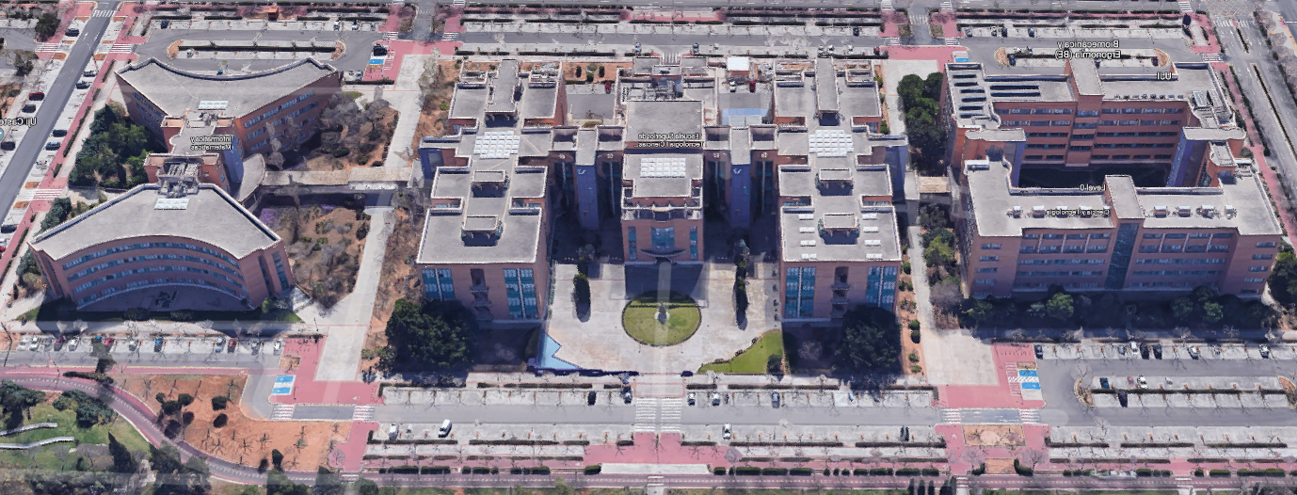
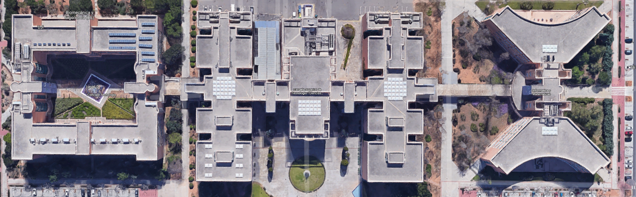
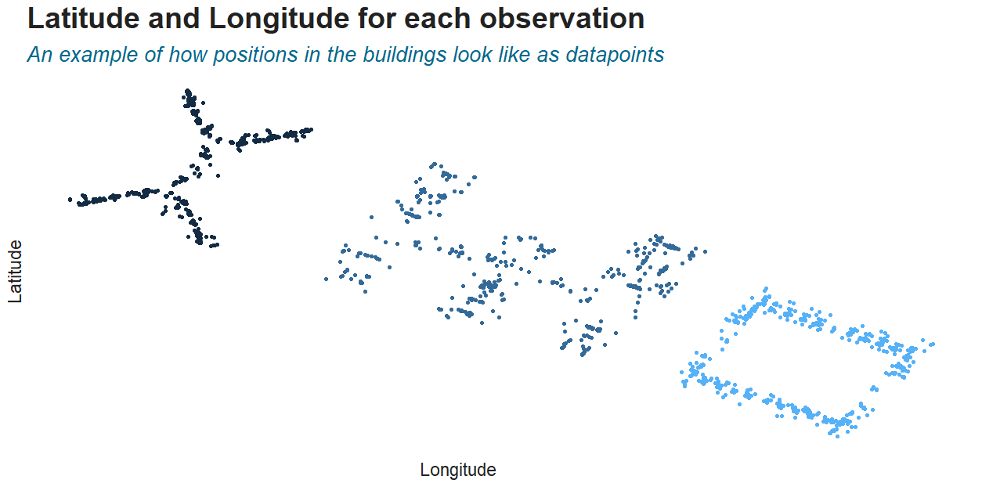
About the assignment
Research the feasibility of “Wi-Fi fingerprinting” for indoor localization.
Signal strength measured in dBm (decibels relative to a milliwatt).
Data was collected in 3 buildings at the Jaume I University in Valencia, Spain
Signal Strength (dBm) |  | Connection
-30 |  | Amazing
-67 |  | Good
-70 |  | Medium
-80 |  | Bad
-90 |  | Unusable
Source: https://www.metageek.com

Slide 5
What are we trying to predict?
How?
Use dBm data of 520 Wireless Access Points (routers/WAPs)
Preprocess this so a predictive model can be trained
Test the model on a new dataset to see its predictive accuracy
Determine the errors made by the model and reconfigure
Building
Floor
Latitude
Longitude

Slide 6




So in short…
010111001111
X
Learn
Analyze
data
Model
Test
Analyze
errors

Slide 7

General preprocessed parts
Remove rows and columns without variance
Normalized the rows
Dealt with unusual parts within the data (case dependent)
Evaluated multiple agorithms

Slide 8
Building
Trained the model to ignore dBm values from -90 & lower in building 1 & 3
Trained the model to ignore dBm values from -75 & lower in building 2
Model’s predictive accuracy when tested: 0.999%
1 out of the 1111 observations was incorrectly predicted

Slide 9
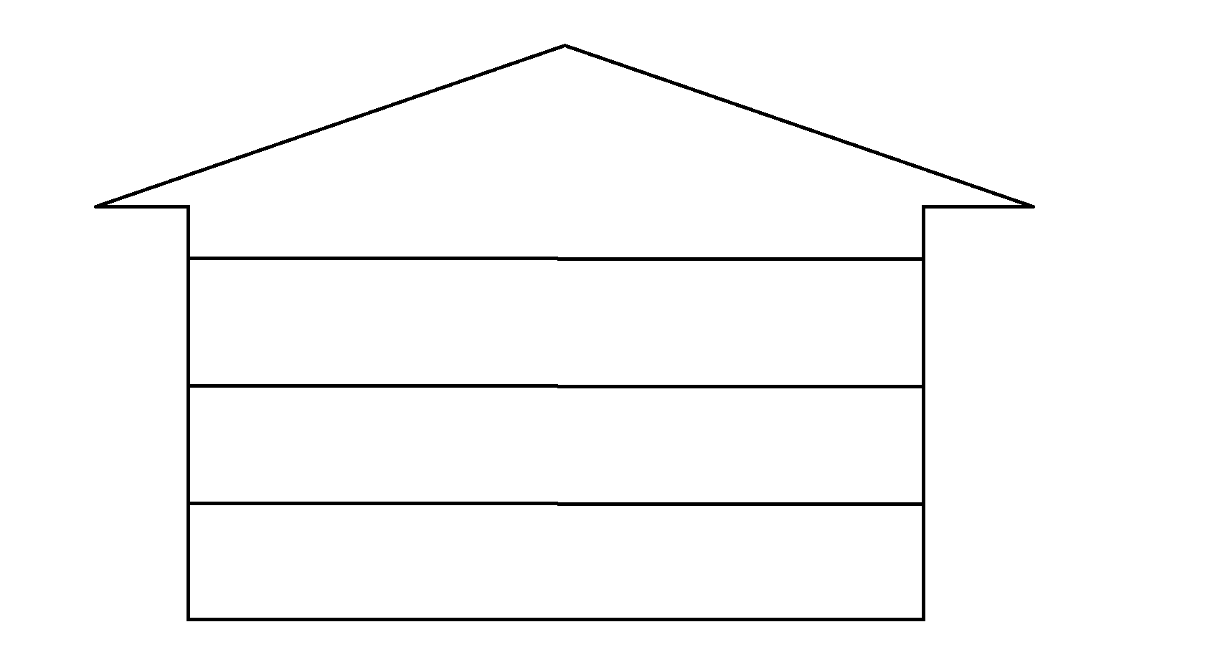
Floors
= Building
= Observation
Oversampled observations in troublesome areas
Altered minimum dBm signal strength
Accuracy: 96,22%
Floor 4
Floor 3
Floor 2
Floor 1

Slide 10



Latitude & Longitude
Used a wide range of dBm values (so didn’t alter the lowest values too much)
Removed all duplicate rows
Latitude:
RMSE = 6.734
R^2 = 0.991
MAE 4.6
Longitude:
RMSE = 7.377
R^2 = 0.996
MAE 4.9
~4.6m
~4.9m

Slide 11

What did I learn?
Task specific knowledge
There is an explanation for why a model is inaccurate, you just have to find it
Think out loud. If you cannot formulate your problem, do you even understand it yourself?
Even if something seems difficult to pull off, just try it and see whether you can get it to work

Slide 12
Questions!

Slide 13
